Slide 1

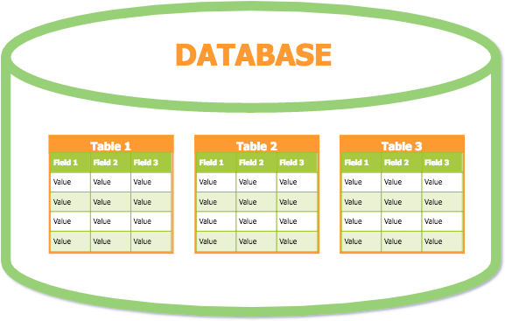
Lesson 11
SQL Views and Triggers
1

Slide 2
Database View
A virtual table which contains data derived from other tables based on a result-set of an SQL statement.
A way of specifying a table that is referred frequently, even though it may not exist physically.
Can join multiple tables together and use the view to present the data as if the data is coming from a single table.
Views simplify complex queries.
– Hide the complexity of SQL statements with many joins.

Slide 3
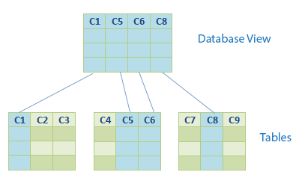
Database View

Slide 4
Database View
When the data of base tables change, the view reflects that change.
Always show up-to-date data.
The database engine recreates the data, using the view's SQL
statement, every time a user queries a view.
Views are stored queries that produce a result set when referenced.
– Database system stores database views as a SQL
SELECT statement with joins.

Slide 5
Create View
CREATE VIEW <view_name>
AS
SELECT <column1, column2, ...> FROM <table_name>
WHERE <condition>
Execute View
SELECT * FROM <view_name>

Slide 6
Create View
If none of the view attributes results from applying functions or arithmetic operations, do not have to specify new attribute names for the view.
The attribute names would be the same as the names of the attributes of the defining tables in the default case.
NOTE: Can write any advance SELECT statement within the body of the VIEW.

Slide 7
Example
CREATE VIEW View_Employee AS
SELECT *
FROM Employee WHERE Dno = 5
To retrieve records:
SELECT * FROM View_Employee

Slide 8
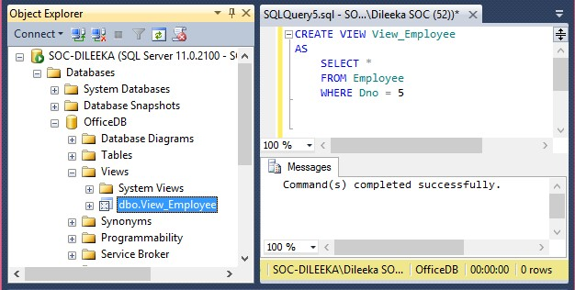
Example

Slide 9
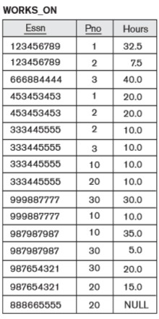
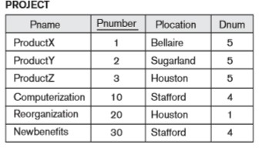
Exercise
Create a view to display employee name, project name and hours that each employee works on a project.

Slide 10
Exercise
Retrieve the last name and first name of all employees who work on the ‘ProductX’ project using WORKS_ON1 view.

Slide 11
Exercise
Display the Dept_no, Total No. of employees in each department and the total salary given to all the employees in each department.

Slide 12
Retrieve Records
Retrieve the details of ‘Research’ department.

Slide 13
SQL Triggers
Used to specify automatic actions that the database system will perform when certain events and conditions occur.
Provide an alternative way to check the integrity of data and also to run scheduled tasks.
It is a stored program that executes automatically in response to a specific event associated with a table.
Insert
Update
Delete

Slide 14
SQL Triggers
Can’t invoke explicitly.
Invoke automatically after performing the required action on the table that it is assigned to.
A trigger must be associated with a specific table.
Without a table trigger would not exist.

Slide 15
SQL Trigger Syntax
CREATE TRIGGER <trigger_name>
ON <table_name> FOR <trigger_event> AS
<SQL Statements>
<SQL Statements>
….

Slide 16
Trigger Name
Better to follow this format in naming triggers.
[table_name]_[trigger_event]
Eg: Employee_Insert

Slide 17
Trigger Events
Trigger event causes a trigger to be invoked.
Trigger event can be INSERT, UPDATE or DELETE.
A trigger can be invoked by only one event.
To define a trigger that is invoked by multiple events, you have to define multiple triggers, one for each event.

Slide 18
AFTER Triggers
Specifies that the trigger should be executed after the operation specified in the event is completed.
Trigger will activate AFTER the change is made on the table.
AFTER INSERT
AFTER UPDATE
AFTER DELETE

Slide 19
INSERT Trigger Example
CREATE TRIGGER Employee_Insert
ON Employee AFTER INSERT AS
SELECT * FROM Employee
NOTE: Can write any advance SQL statement within the body of the TRIGGER.

Slide 20
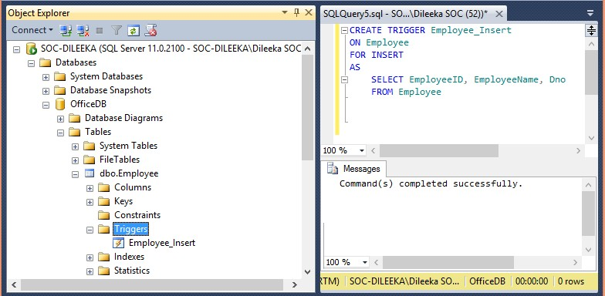
Example

Slide 21
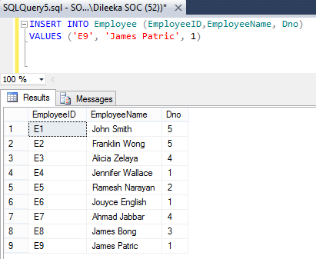
Example

Slide 22
UPDATE Trigger Example
CREATE TRIGGER Employee_Update
ON Employee AFTER UPDATE AS
SELECT * FROM Employee

Slide 23
DELETE Trigger Example
CREATE TRIGGER Employee_Delete
ON Employee AFTER DELETE AS
SELECT * FROM Employee

Slide 24
Thank You
24

